Slide 1



Assessing the utility of fisheries-dependent data to support mixed fisheries management: a spatiotemporal simulation framework
Paul J. Dolder, Cóilín Minto, Jean-Marc Guarini and Jan Jaap Poos
paul.dolder@gmit.ie

Slide 2
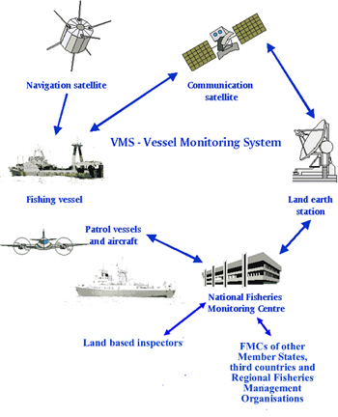
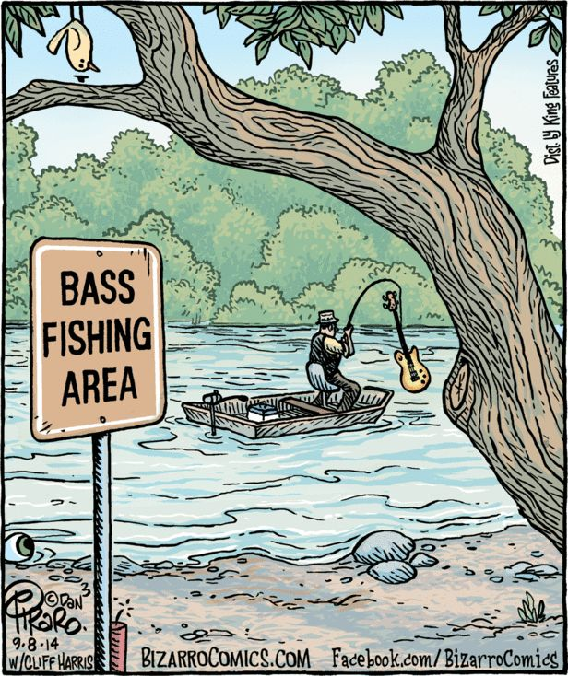
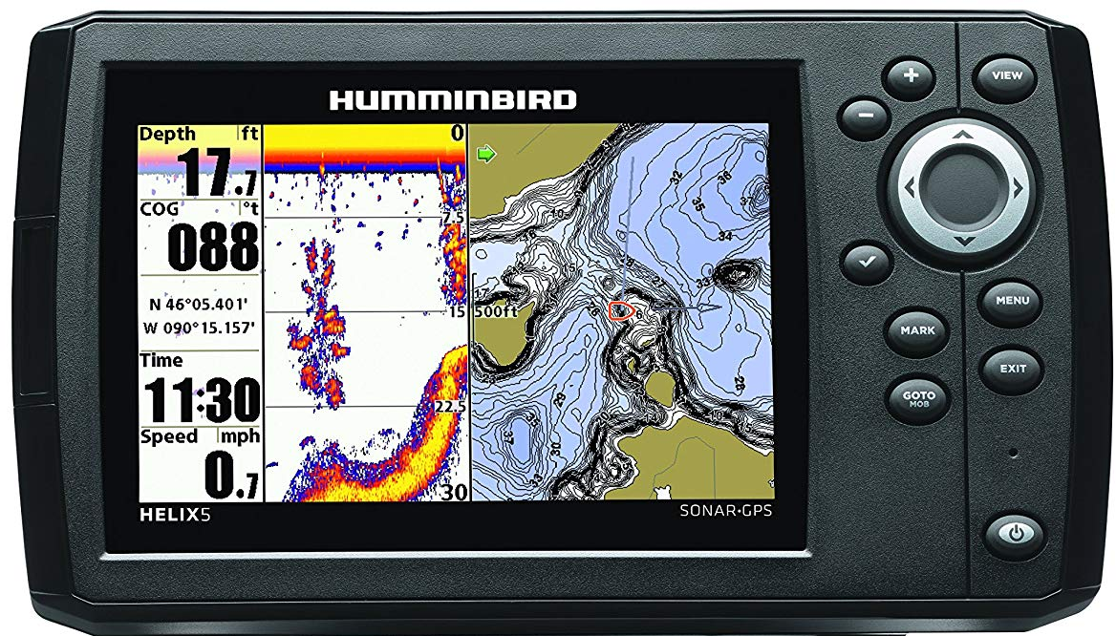
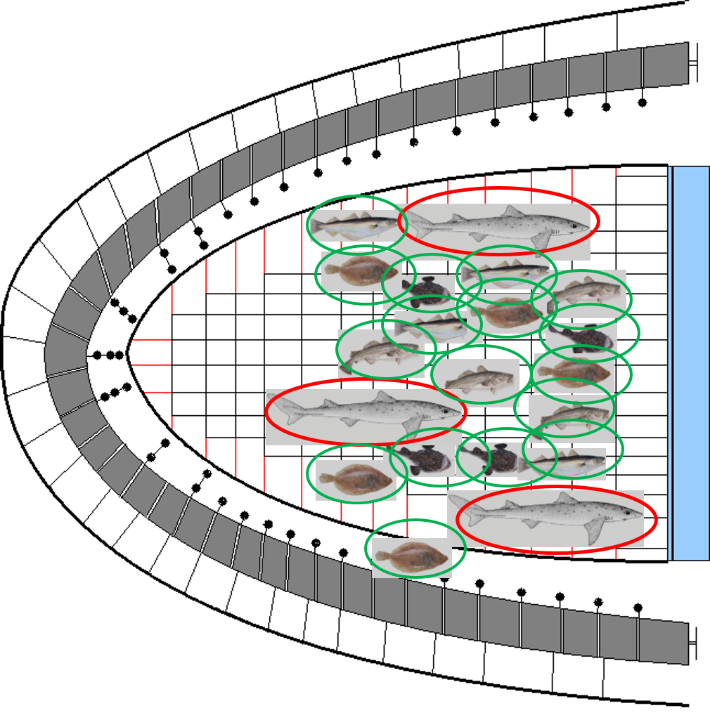

Fishing is an inherently spatiotemporal process
Fisheries catch multiple heterogeneously distributed fish stocks
Uncertainty about distribution in space-time
Provides lots of data
…but a biased sampling process: spatial (and gear-based) targeting
Notes:
Fishing is a spatial process: both populations being heterogeneously distributed and decisions about where to fish
Set in backdrop of uncertainty about what you might catch
Fishing provides a lot of data on locations fished and catch (landings)
But data is biased from the fishing process: spatial and gear based targetting

Slide 3
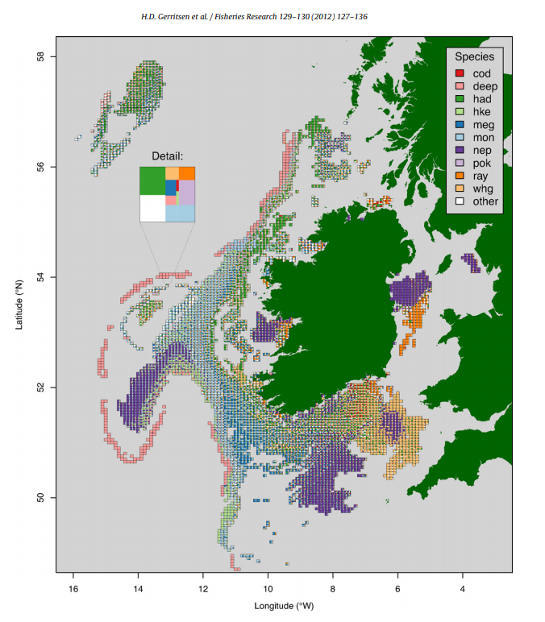
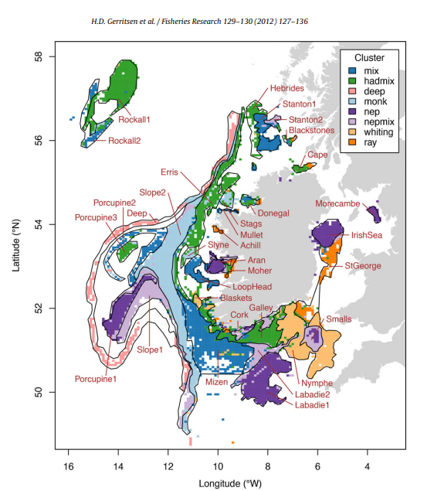
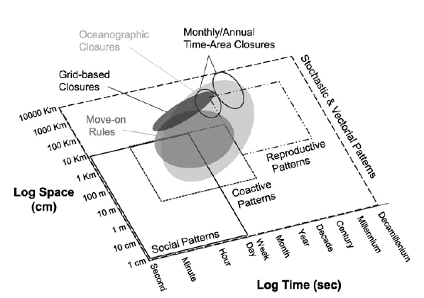
Increasing use of fisheries-dependent data to understand mixed fishery dynamics
Dunn et al 2016. PNAS 113(3) 668-673
Increasing interest in spatiotemporal management in mixed fisheries
Spatial and temporal resolution of fisheries-independent survey data sparse
Use of fisheries-dependent data, but fishing biased sampling process
True distribution of populations unknown
Notes:
Surveys don’t have spatial or temporal coverage to inform management of finer scale processes
Fisheries dependent data increasingly used ad-hoc, without understanding of underlying dynamics
Provides motivation for developing a simulation framework where underlying true dynamics are known

Slide 4
What Qs do we want to answer?
Q1. Do catches observed from the fishery reflect the underlying population structure?
Q2. At what spatial and temporal scales of aggregation are appropriate for management (does the “true” population signal degrade)?
Q3. How “useful” is commercial data for implementing spatial fisheries management measures within a mixed fishery?
Notes:
Want to answer these 3 questions:

Slide 5
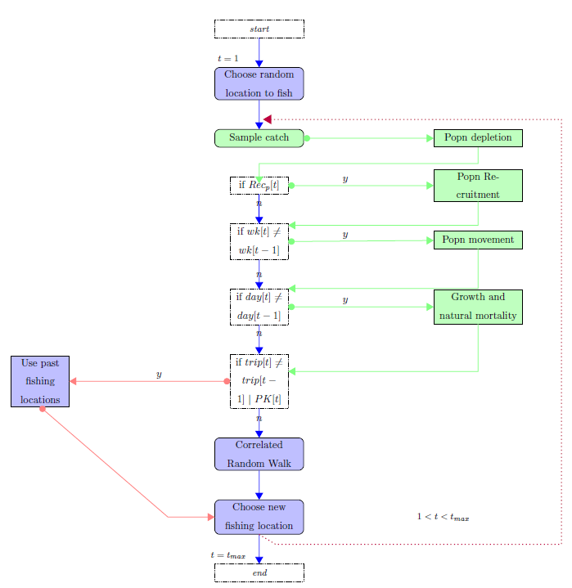
Introducing MixFishSim
Modular, event-based:
Spatial population dynamics
Vessel-level (agent-based) fishing dynamics
Highly resolved
Temporally
spatially
True population structure known at each time-step
Notes:
Developed a modular simulation framework.
Highly spatially and temporally resolved
True population dynamics (spatiotemporal) known at each timestep

Slide 6
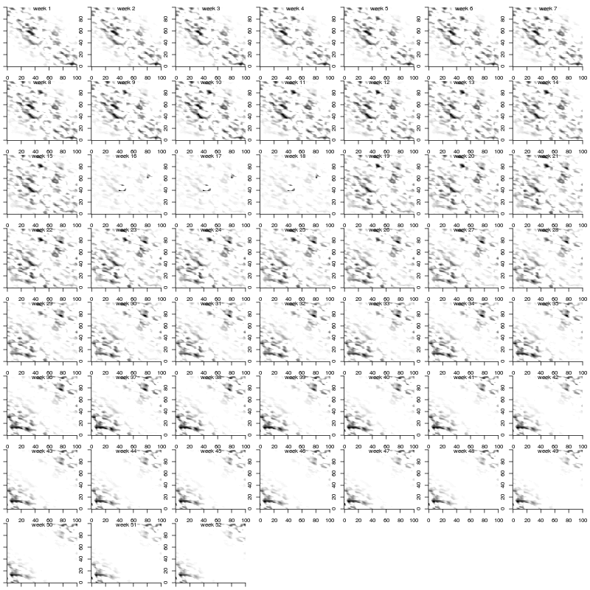
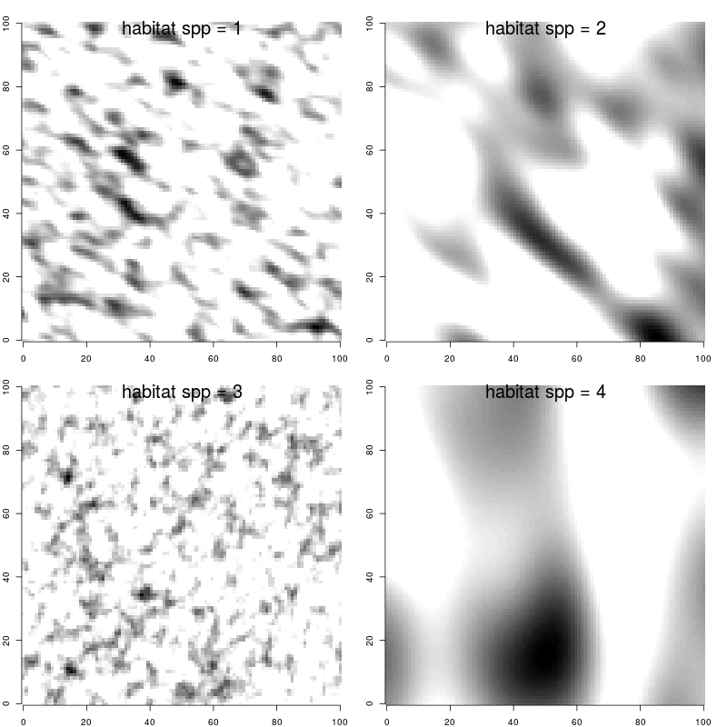
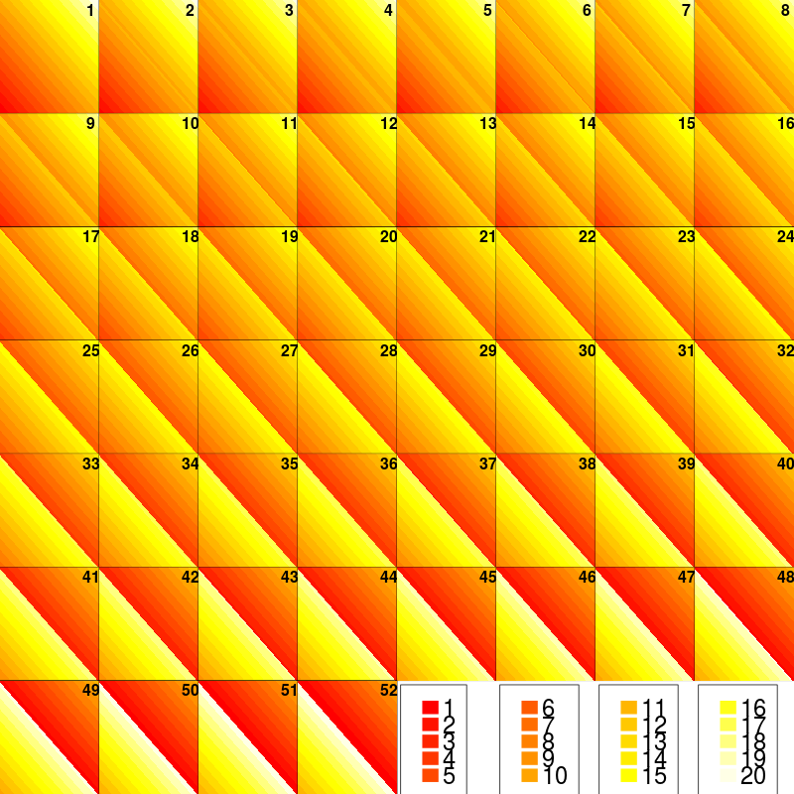
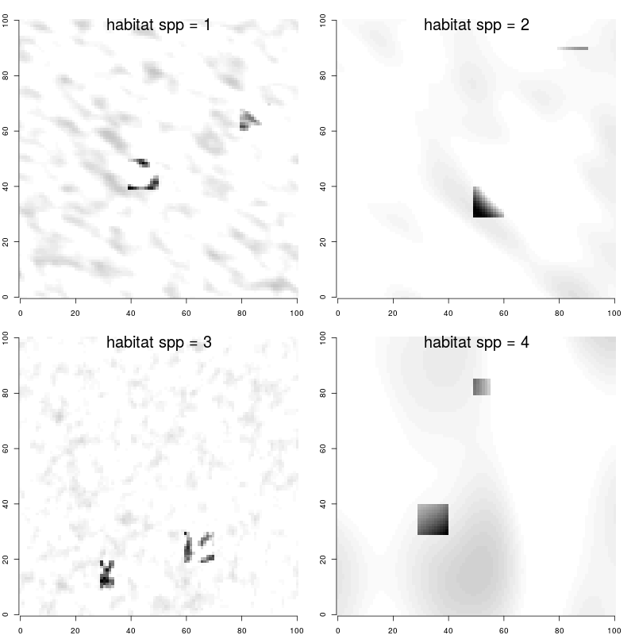
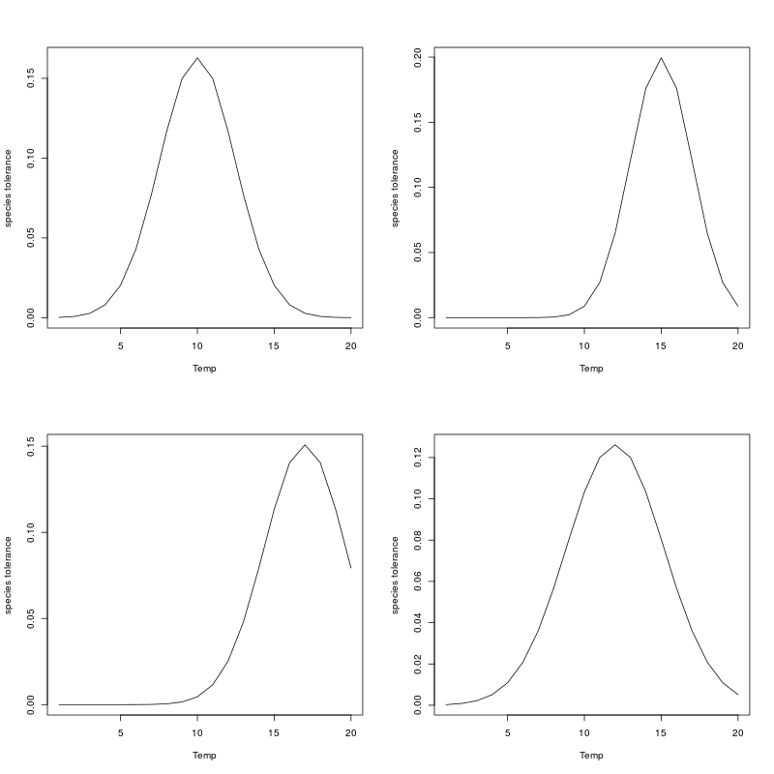
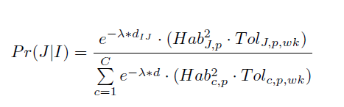
Gaussian Random Fields define habitat suitability
Define a GRF process per population for habitat suitability
Define spawning grounds per population >> increased affinity to spawning grounds during certain weeks
Define a temperature field per week, and individual population tolerances
Populations move between cells according to maximum distance, habitat suitability and temp tolerance
Notes:
GRF process to define habitat suitability
Spawning grounds defined for certain times of year
Temperature field, changing weekly with species temperature tolerances
ALSO, population dynamics at high spatial resolution: 2-stage delay difference model, recruitment, depletion, growth and mortality (daily)
Populations move between cells accordingly to distance-decay, habitat relationship and temp tolerance

Slide 7
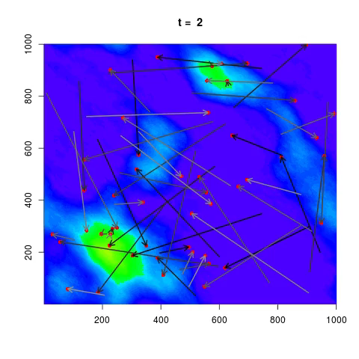
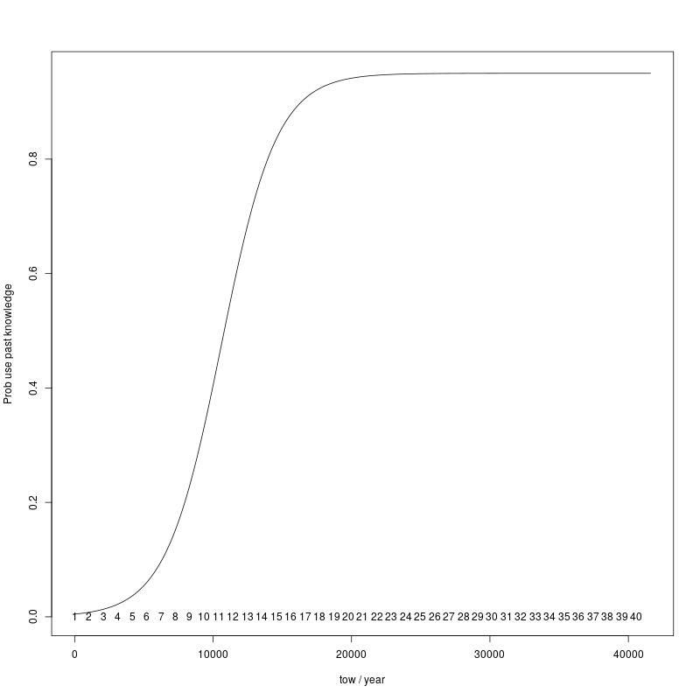
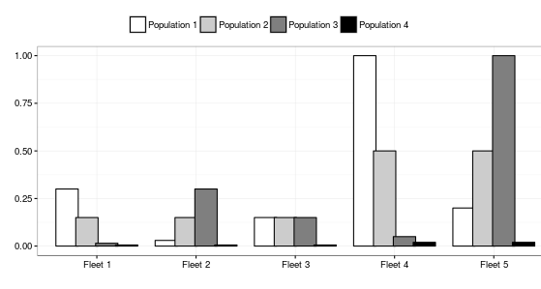
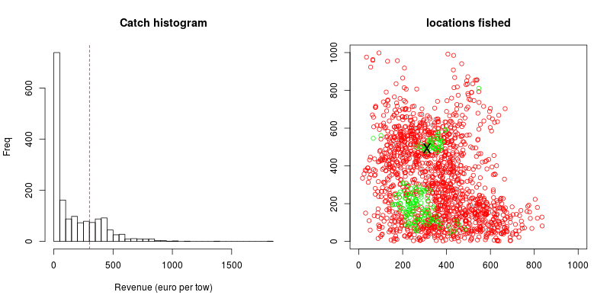
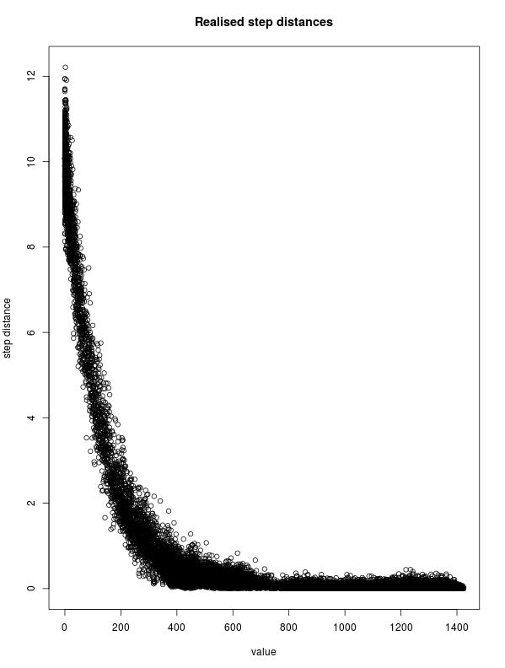
Individual vessel-based fishery dynamics
Transition from exploratory to established fishery
Exploratory:
Correlated Random Walk
Transition:
Mix
Established:
(mostly) past experience of individual
Established phase
Transition phase
Exploratory phase
Notes:
Fishery dynamics:
From exploratory to established: correlated random walk, with increasing incorporation of individuals knowledge of “good” fishing grounds

Slide 8
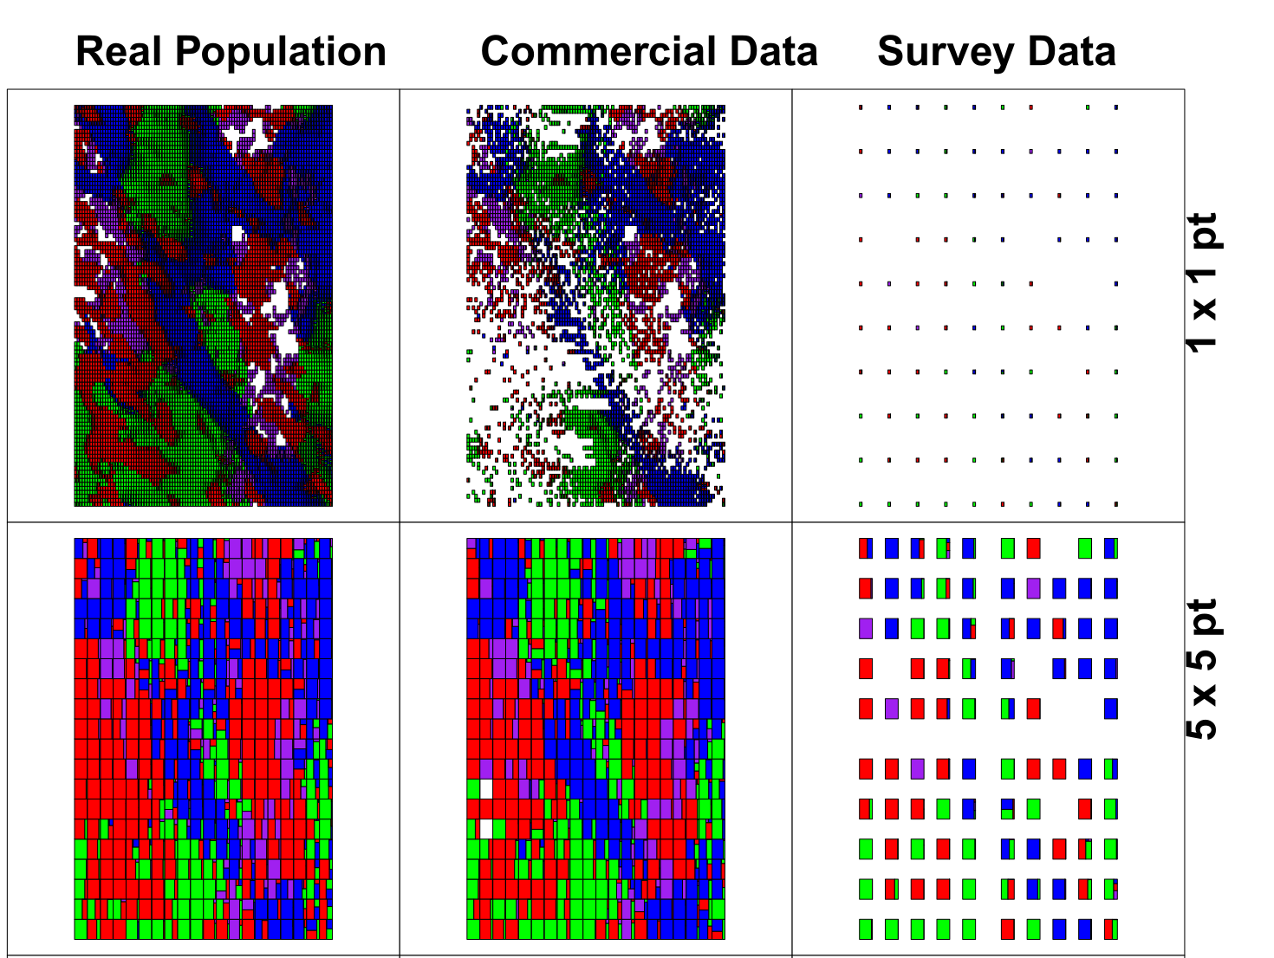
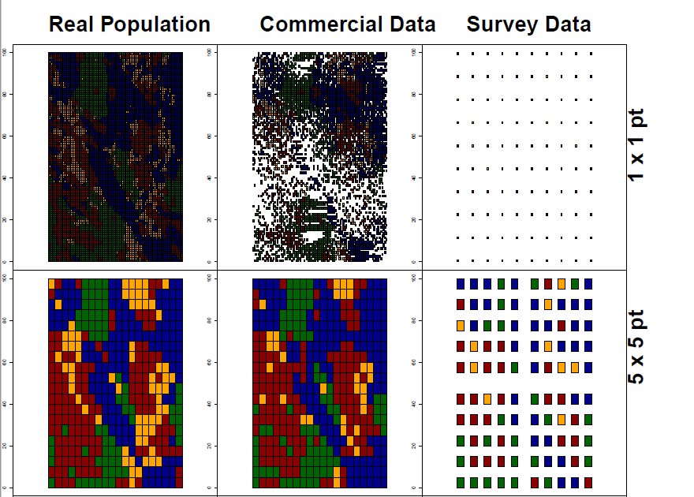
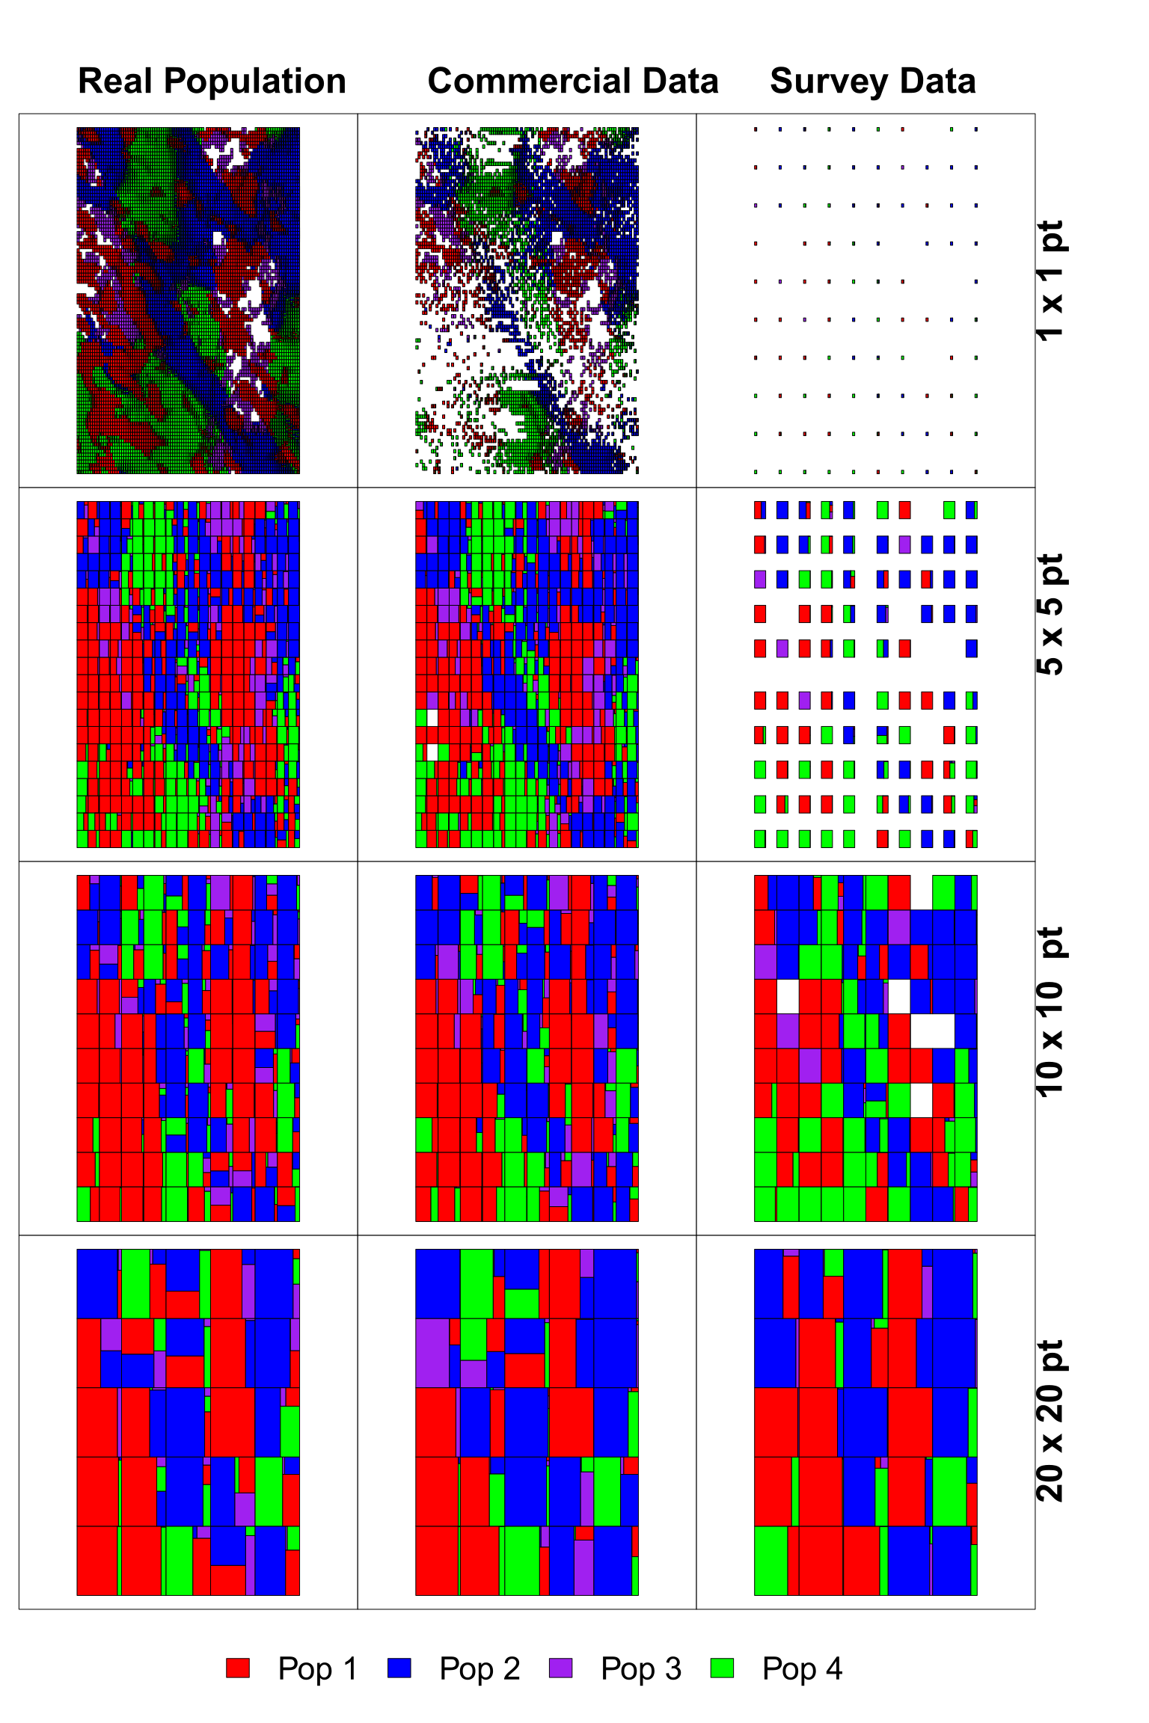
The Spatial dimension
Commercial data (despite its biases) shows reasonable relation to the underlying population structure
Survey data spatial sparse which can lead to some inconsistencies when more aggregated
Commercial and survey have data gaps: inference from modelling necessary
Notes:
Similar patterns to those reproduced from VMS derived fishery data
At finescale resolution, fishery data represents well the underlying pop structure but data gaps
Even with some level of aggregation, gives similar patterns
Clustering results in broadly similar areas defined

Slide 9
Simulation experiment: spatial closures
4 populations
5 fleets of 20 vessels each
40 year simulation
20 years to establish
10 year “data”
10 year closure to protect a population
3 data sources:
“real” population
Inferred from fishery
Inferred from “survey”
3 temporal resolutions:
Weekly
Monthly
Yearly
4 spatial resolutions
1 x 1
5 x 5
10 x 10
20 x 20

Slide 10
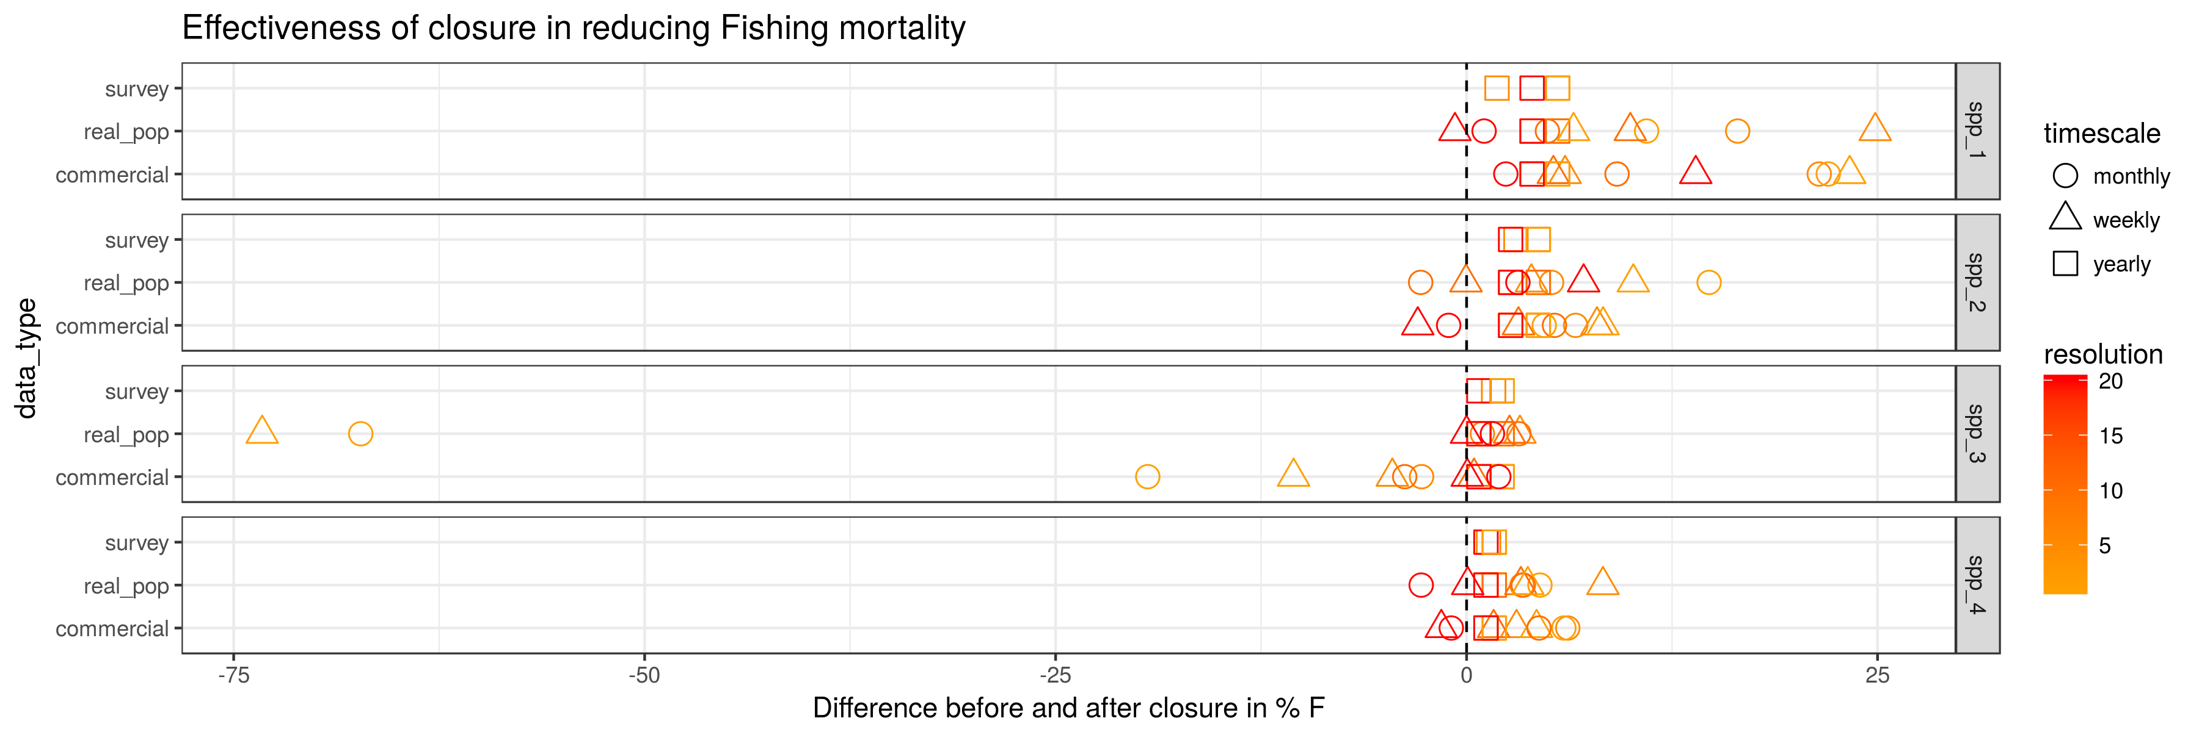
Simulated closure “experiment”
Scenarios based on “real population” most effective, though not for annual closures (no single location effective).
Scenarios based on survey ineffective (as above).
Scenario based on commercial data were effective in some cases, best was 1 x 1 grid aggregated to a monthly level (sufficiently captures temporal dynamics, more spatial data due to increased samples).
Notes:
3 things:
Real population by far most effective, but not at annual data level when aggregation biased causes closures to be less effective
Fishery data closures better at monthly aggregation than weekly: trade-off between amount of data and temporal scale
Spatial aggregation has more effect than temporal (except for annual aggregation, which performs poorly in all cases)

Slide 11
Summary: what can we say about our Qs?
Q1. Do catches observed from the fishery reflect the underlying population structure?
Q2. At what spatial and temporal scales of aggregation are appropriate for management (does the “true” population signal degrade)?
Q3. How “useful” is commercial data for implementing spatial fisheries management measures within a mixed fishery?
Reasonable representation of the simulated populations at finer spatial and temporal resolutions, but then lack sufficient data
Monthly finescale seems reasonable for our experimental system: good compromise between data availability and population movement rates (elsewhere, population move-on rules have been 2-3 weeks)
Commercial data potentially useful and more representative than once-a-year survey, though effectiveness of closure potentially moderated by biases in data (lack of full picture)

Slide 12




Thank you for listening!
Questions?
Contact: paul.dolder@gmit.ie
Acknowledgements:

Slide 13
Extra material

Slide 14
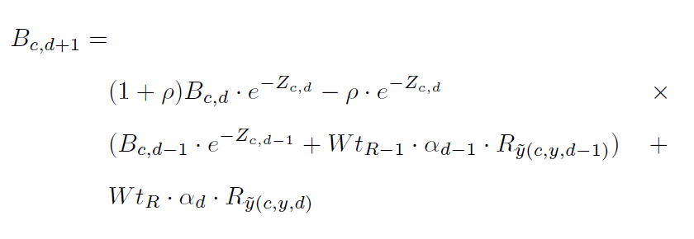
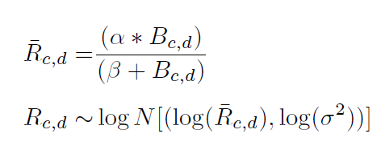
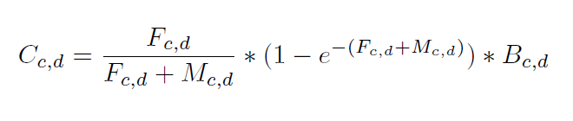
Spatially resolved population dynamics
2-stage biomass delay difference model
Recruitment function
Catch and spatial depletion of population per day

